Slide 1

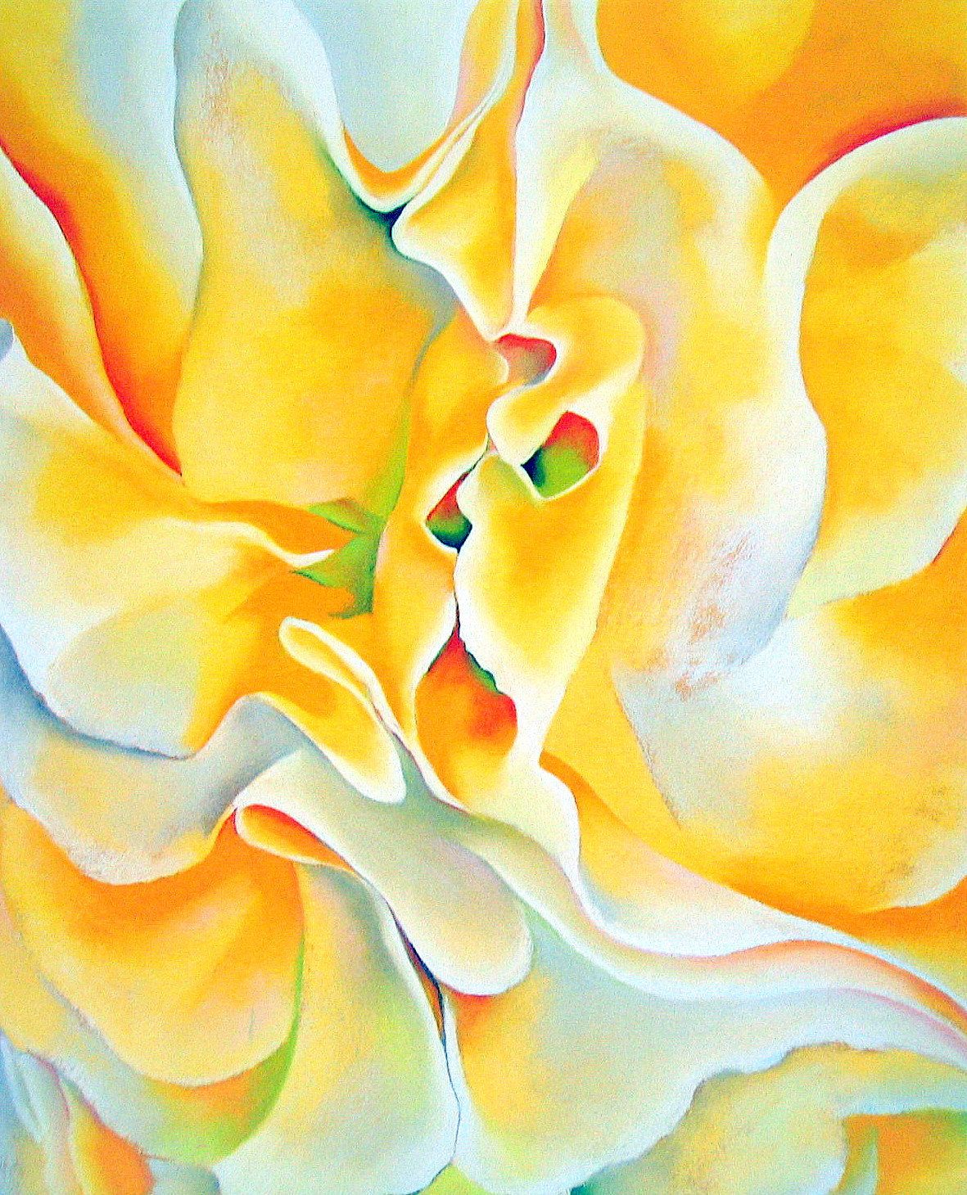
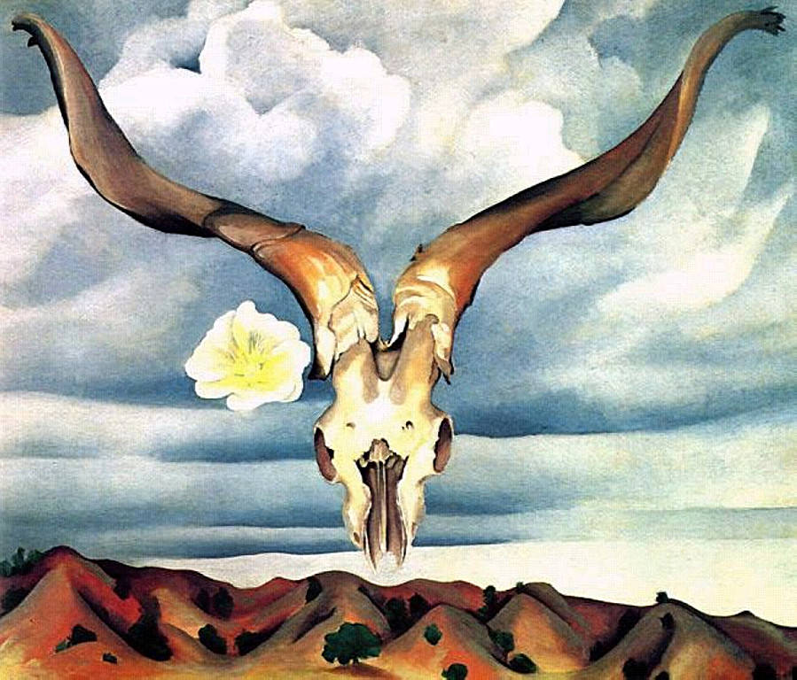
Art Auction
by Bill Shi & Annabel Fang

Slide 2
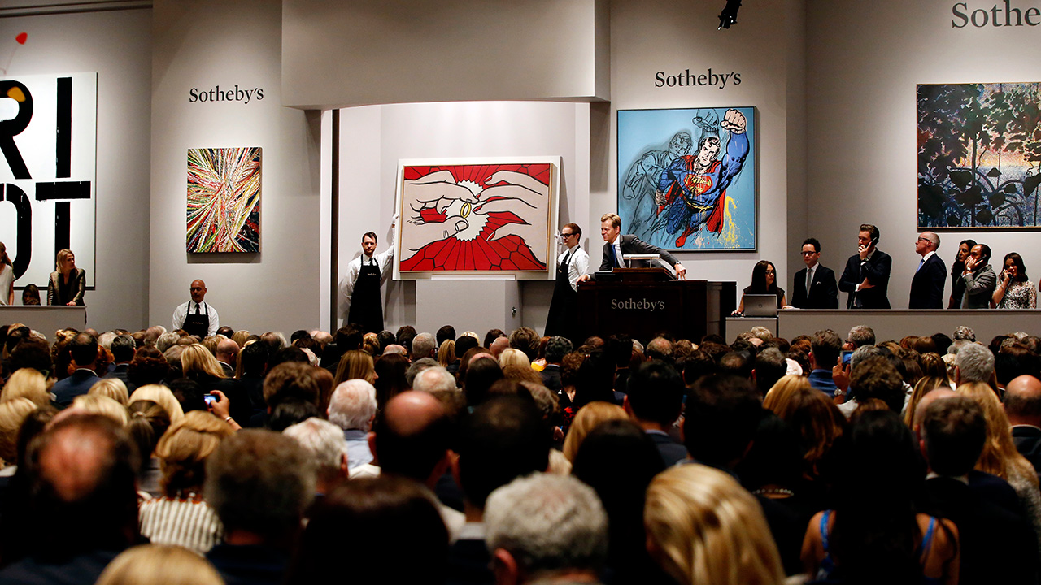
Our Data
Source: askArt.com
Online database containing over 300,000 artists
Contains information about the artists and auction records

Slide 3
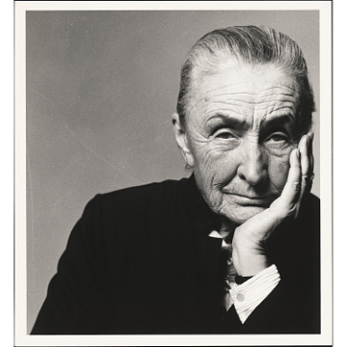
What information are we looking at?
Artists:
ID
Name
Year of Birth
Year of Death (if available)
Art pieces
Name
Size
Year created
Signature
Medium
Auction House
House name
Lot number
Date sold
Georgia O'Keeffe
Notes:
Purpose

Slide 4
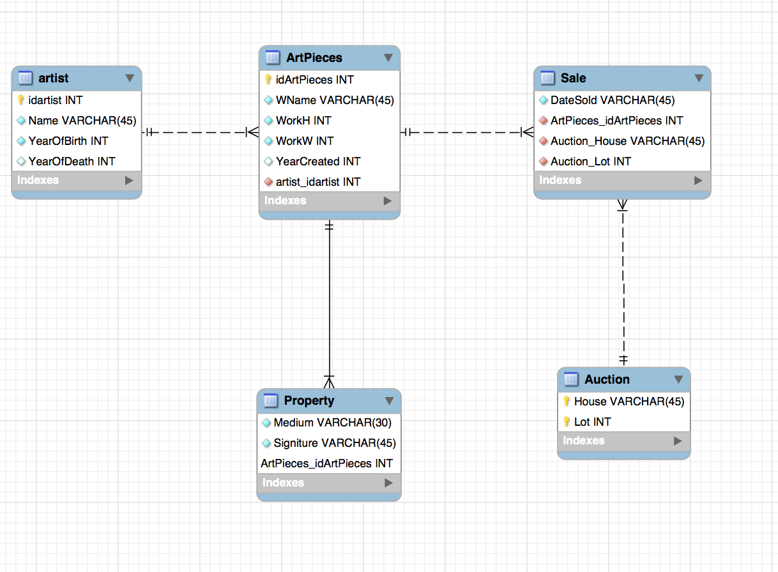
E-R diagram

Slide 5
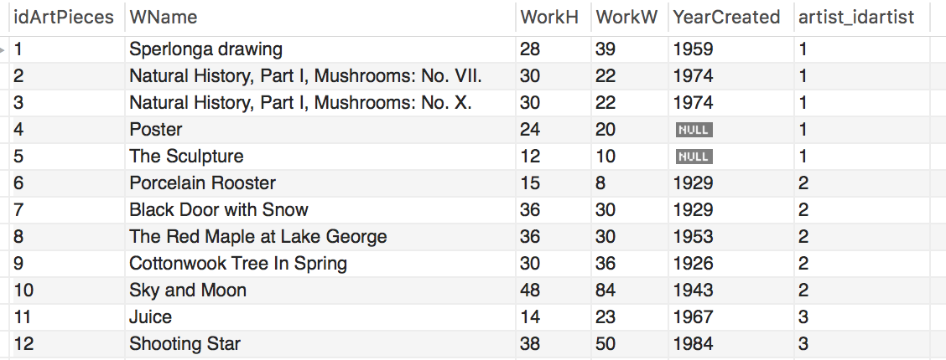
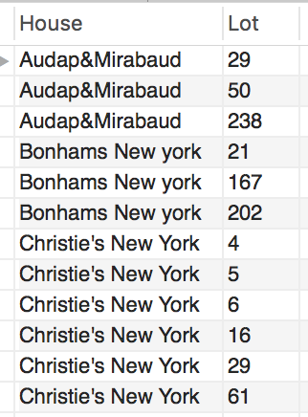
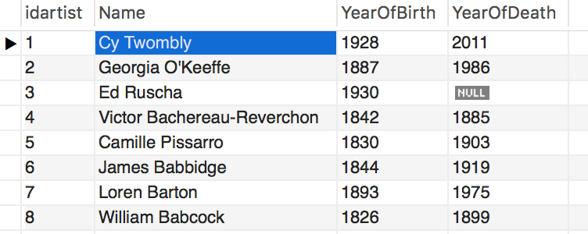
ArtPieces
Auction
Artist

Slide 6
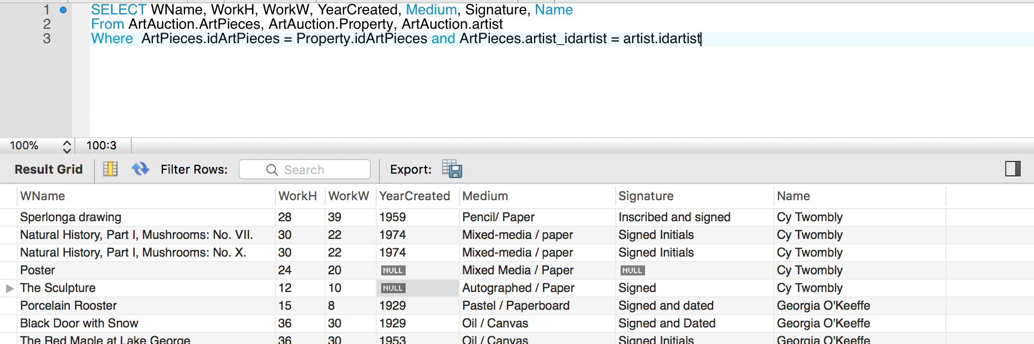
Sample Query

Slide 7
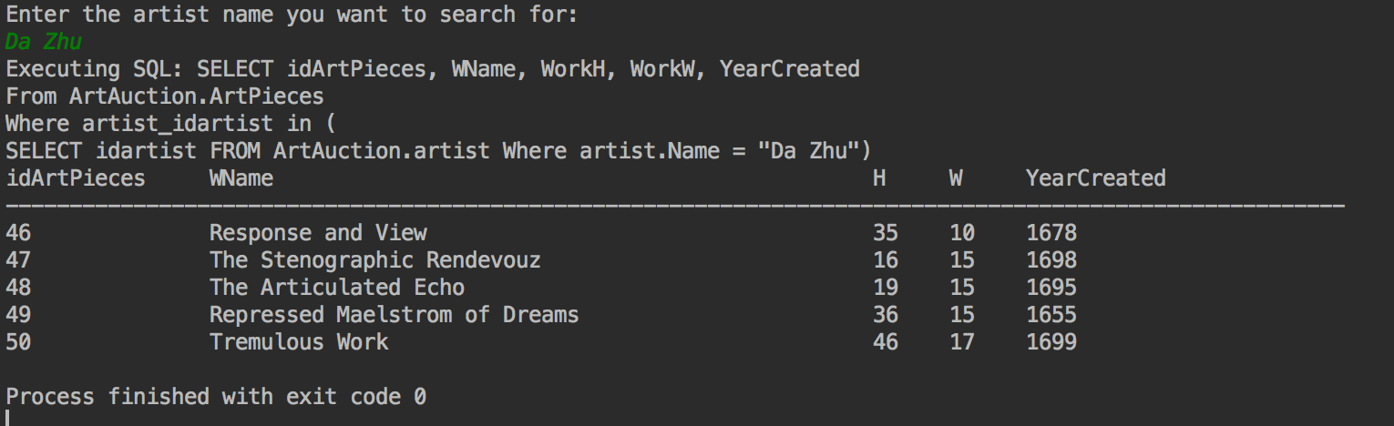
Standard Application

Slide 8

Thank You!

